Slide 1

Distributed Onion Architecture
Jeffrey Palermo
Managing Partner & CEO, Clear Measure
@jeffreypalermo
jeffrey@clear-measure.com

Slide 2
Agenda
What this talk is / what it is not
About myself (who cares, get with the goods!)
Onion Architecture
Distributed Systems
NServiceBus
Putting it all together

Slide 3
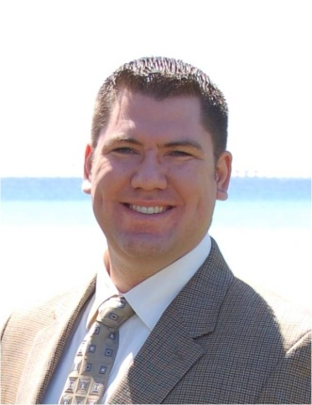




Who is this Jeffrey Palermo guy?
Personal
Father of three
Iraq veteran 2003-2004
Eagle Scout
Christian
Jeep off-roader
Professional
Programming for IIS since 1997
Left Headspring, joined Clear Measure, a full-service custom software company
Written some articles, books, & blogs
Speaker at local conferences, MS Tech Ed, VS Live, DevTeach, etc
Ran Austin .Net User Group from 2005-2011
Microsoft MVP
We are hiring!

Slide 4
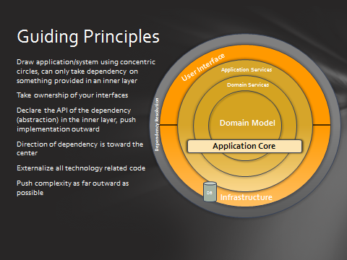

Slide 5
All Demos

Slide 6
Ask questions!
@jeffreypalermo
Jeffrey@clear-measure.com
512-298-1232 x377
JeffreyPalermo.com

